Slide 1
Subnational Indicators from Household Surveys
Jeroen Smits & Iñaki Permanyer
Global Data Lab / Radboud University
Centre for Demographic Studies / Barcelona
jeroen.smits@fm.ru.nl / ipermanyer@ced.uab.es
Presentation to be held at the Webinar of the Sub-National Statistics Sprint
UN Network of Economic Statisticians, September 3, 2025

Slide 2
Jeroen Smits
Professor of economic & human development, Radboud University
Founder Global Data Lab (GDL)
Comparative research on social issues in LMICs
Passion for database building and indicator construction
Iñaki Permanyer
ICREA Research Professor, Centre d'Estudis Demogràfics (CED), Barcelona
Head of the “Health and Aging” unit at the CED
Work on global inequalities in pecuniary and non-pecuniary dimensions of well-being
This presentation
Background information on GDL
Creation of subnational indicators from household surveys
Overview indicators
Discussion of subnational human development indices

Slide 3
Global Data Lab (GDL)
Since 1990s collecting household survey datasets for low- and middle-income countries (LMICs)
Demographic & Health Surveys, Unicef MICS Surveys, IPUMS Census datasets, Barometer Surveys, stand-alone surveys
Combined and harmonized in Database Developing World (DDW)
Information on 35+ million persons in almost all LMICs based on 500+ large household surveys.
Created for multilevel research on social issues in LMICs
Subnational context factors aggregated from DDW combined in GDL Area Database
With introduction SDGs call for subnational indicators
Since then disseminated through GDL website

Slide 4
GDL Area Database
Over 100 subnational indicators for 1300+ regions in 125+ LMICs
Topics include:
Wealth, poverty, asset ownership
Education, work
Position of women, fertility
Child mortality, (reproductive) health
Vaccinations, stunting, under/overweight
Access to public services
Age structure, urbanization
Not all indicators for all countries, but many indicators for many countries
Only years for which household surveys with the required information available
All indicators can be freely downloaded from: www.globaldatalab.org

Slide 5
How created?
We make them ourselves by aggregating information from the household surveys in our database
Educational level of an area is the mean educational level of people of a certain age group
Level of development is mean household wealth
Gender indicator is mean age difference between husbands and wives
Works very well (tests at national level)
High potential (many different indicators possible)
Continuously updated with new indicators, years, countries
Aggregation to other levels possible (e.g. urban/rural, wealth groups, ethnic groups etc.)
Time series since the 1990s.

Slide 7
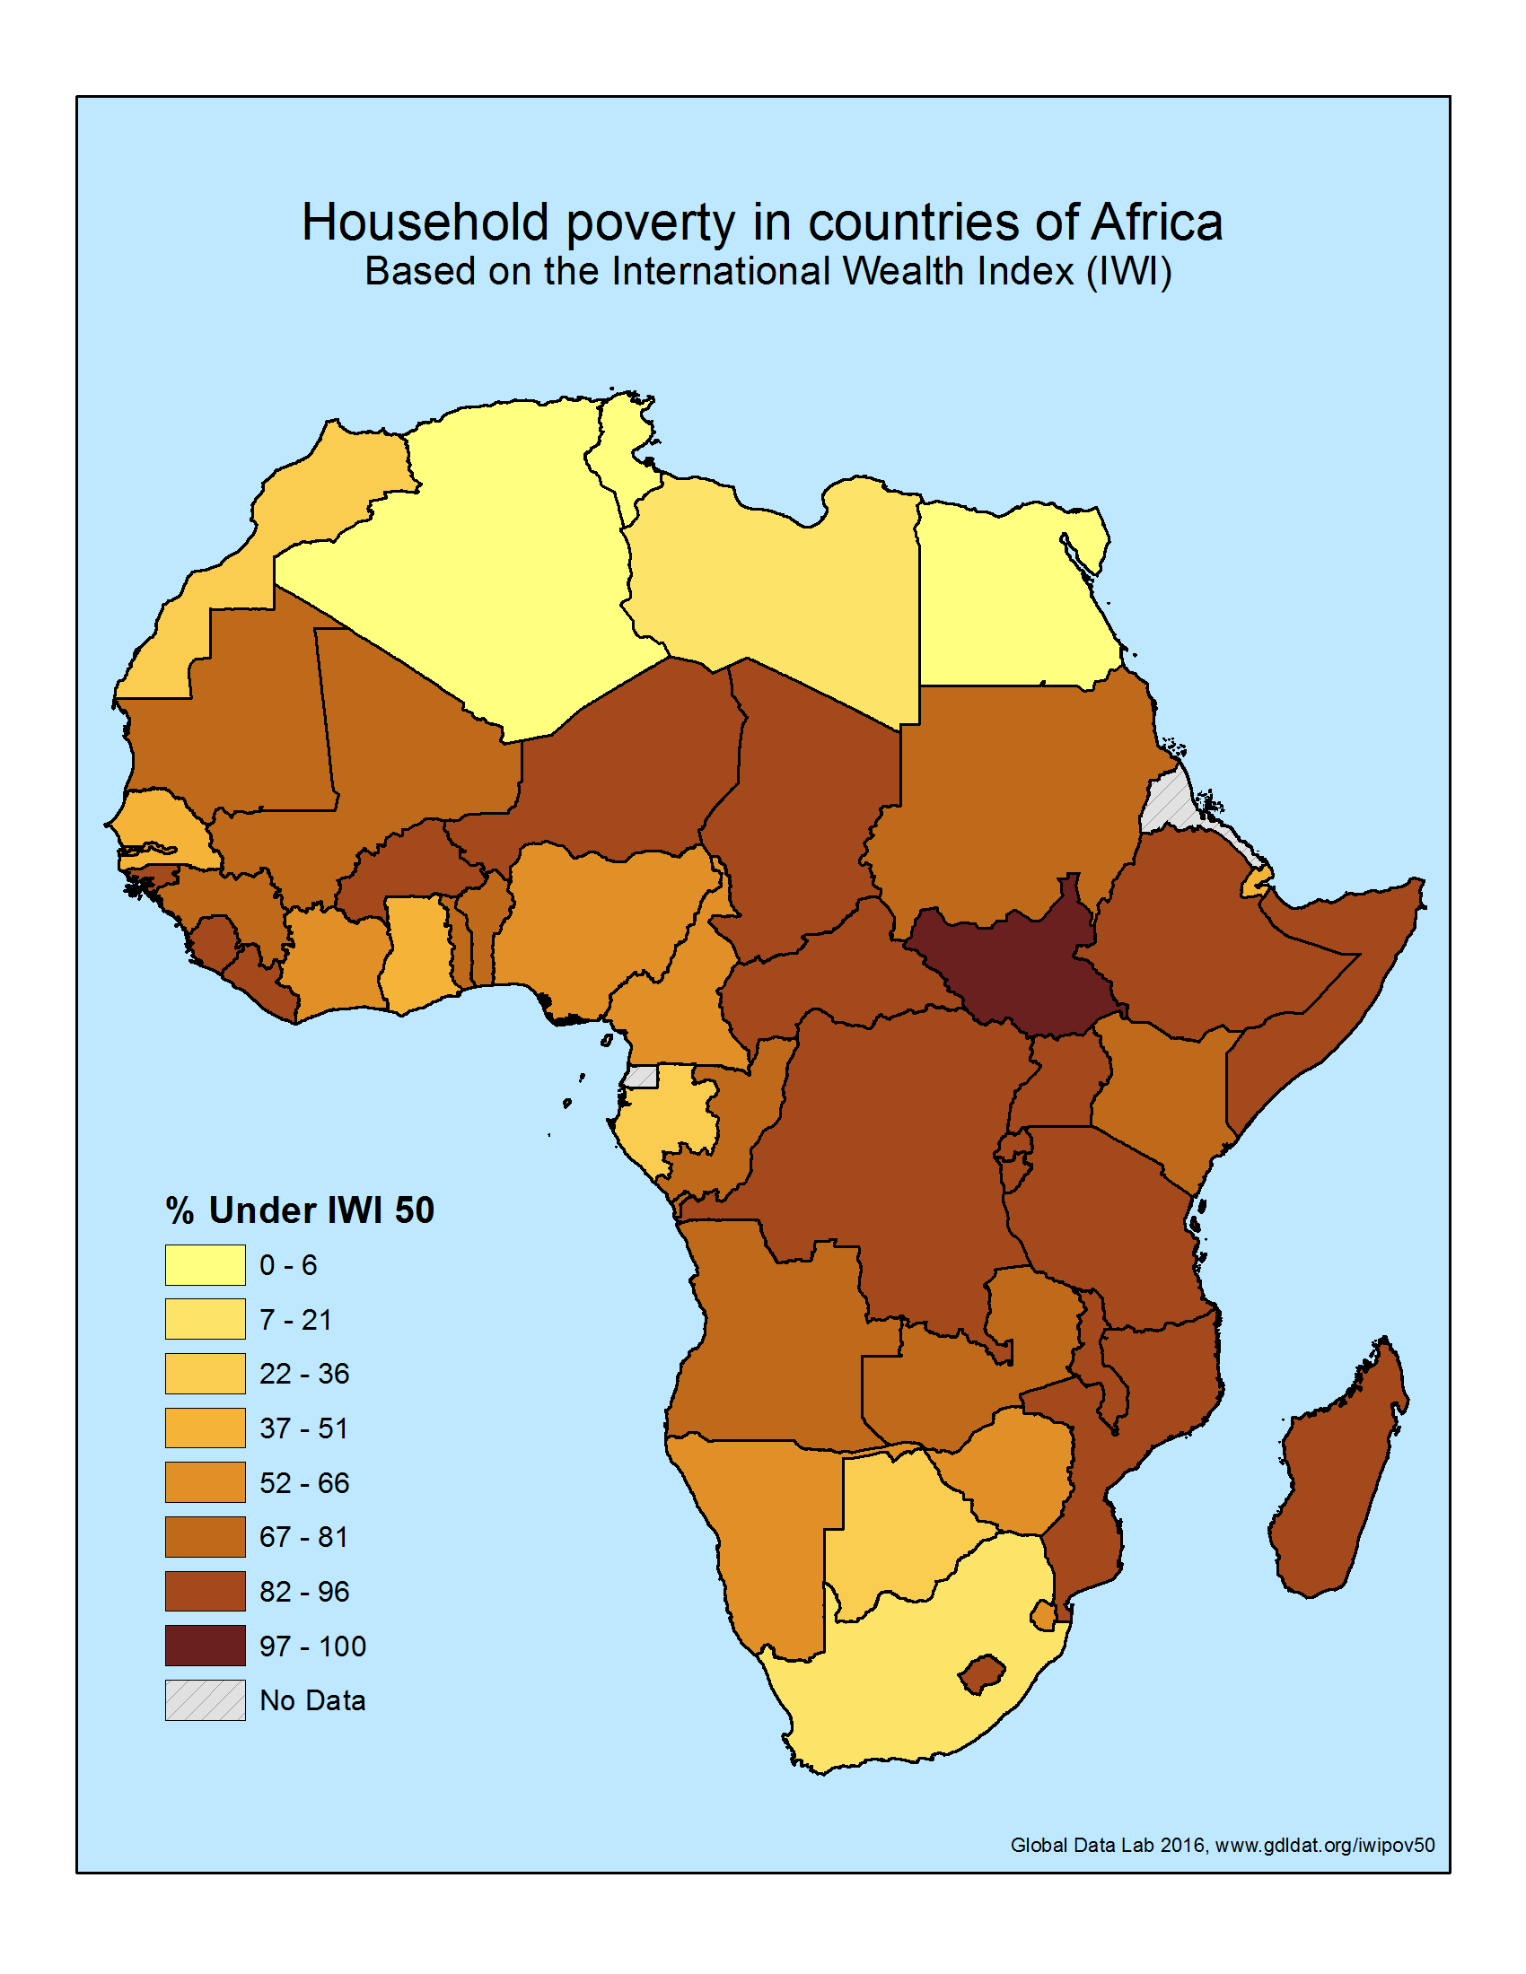

Slide 8
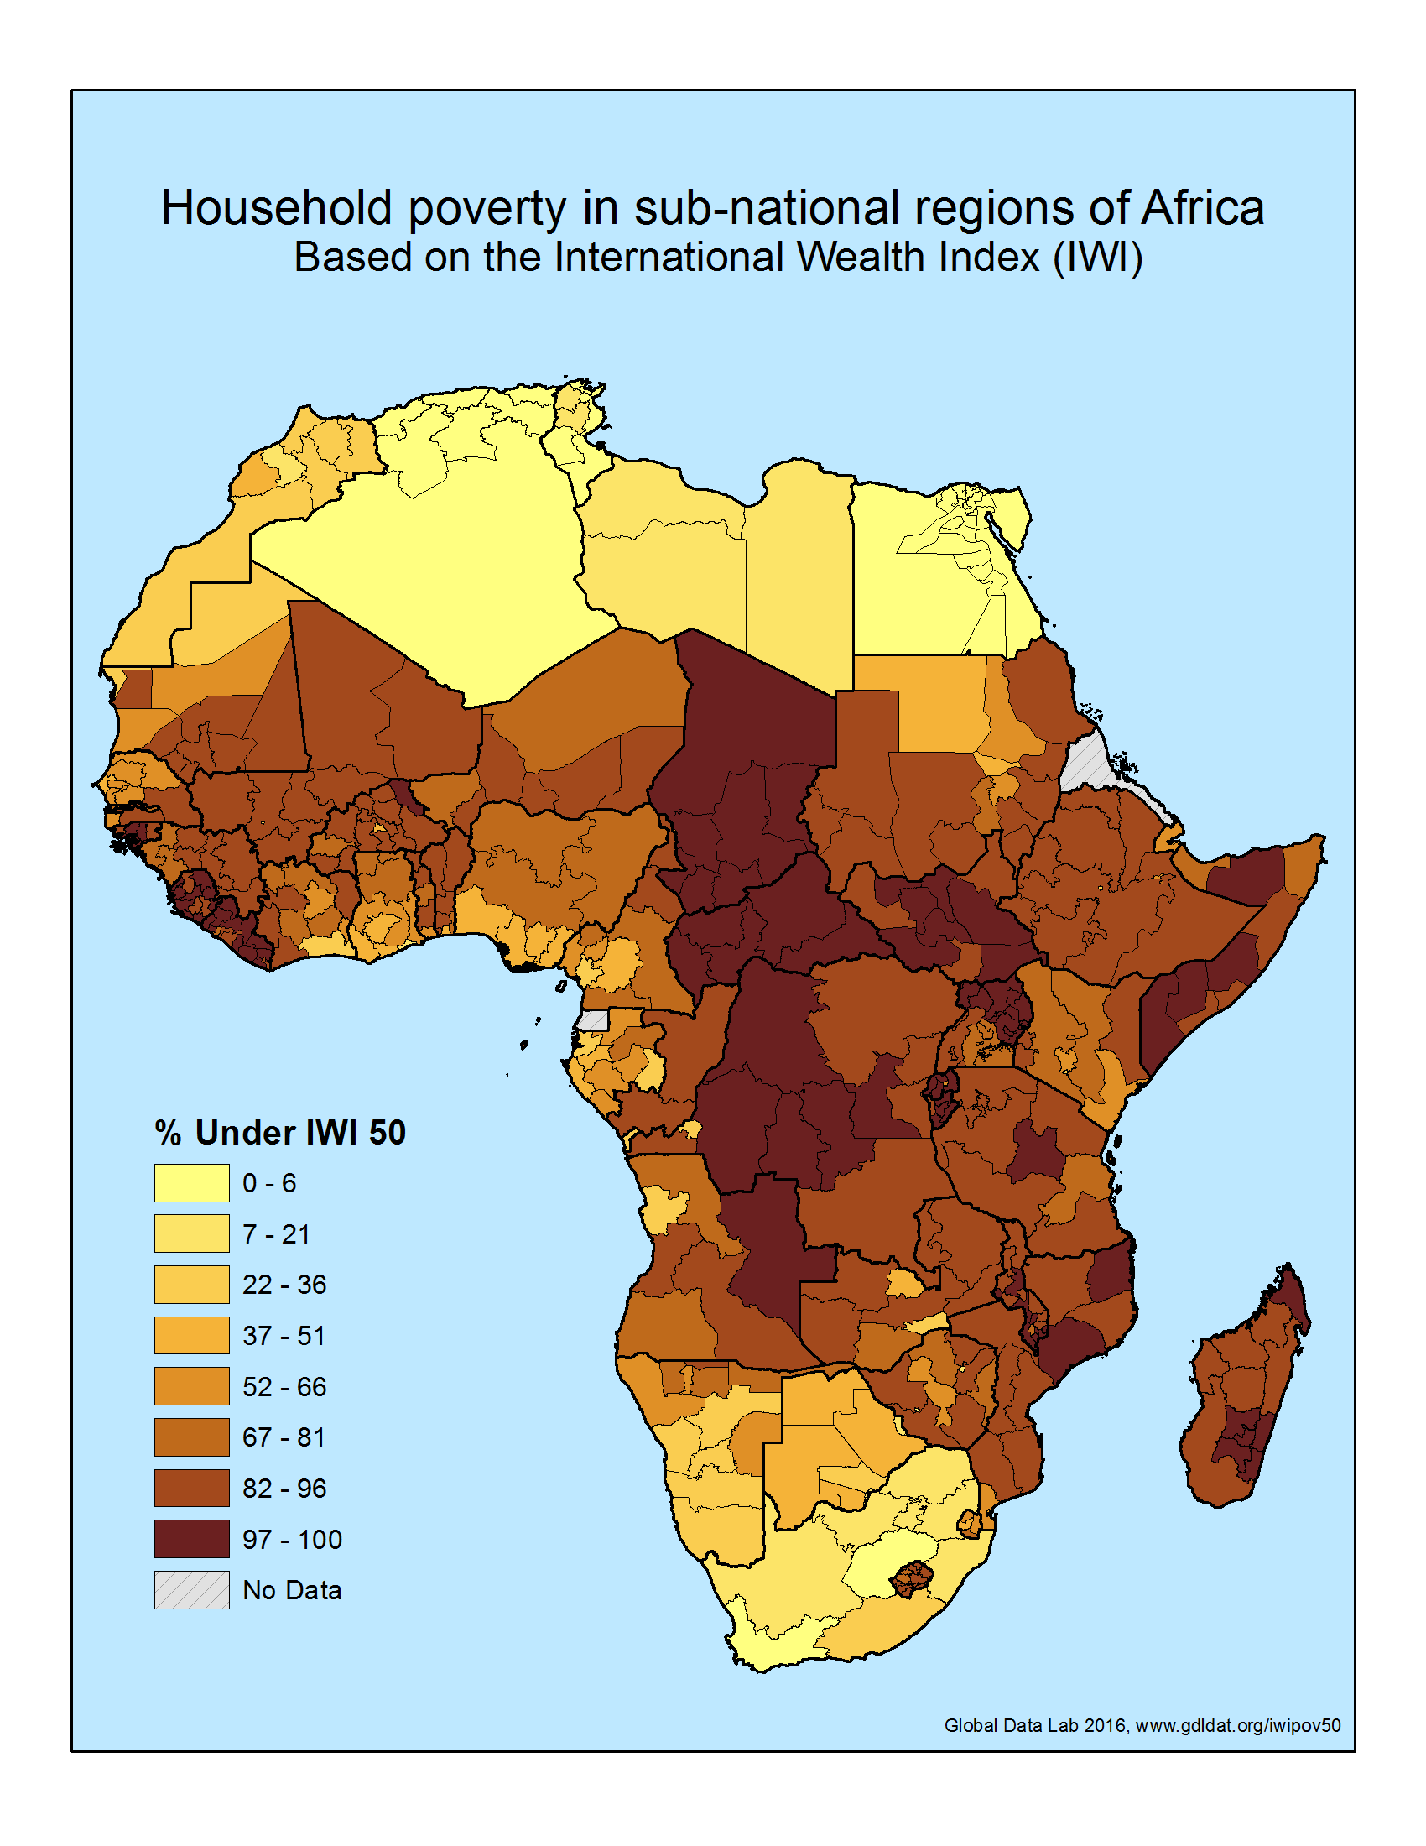

Slide 9
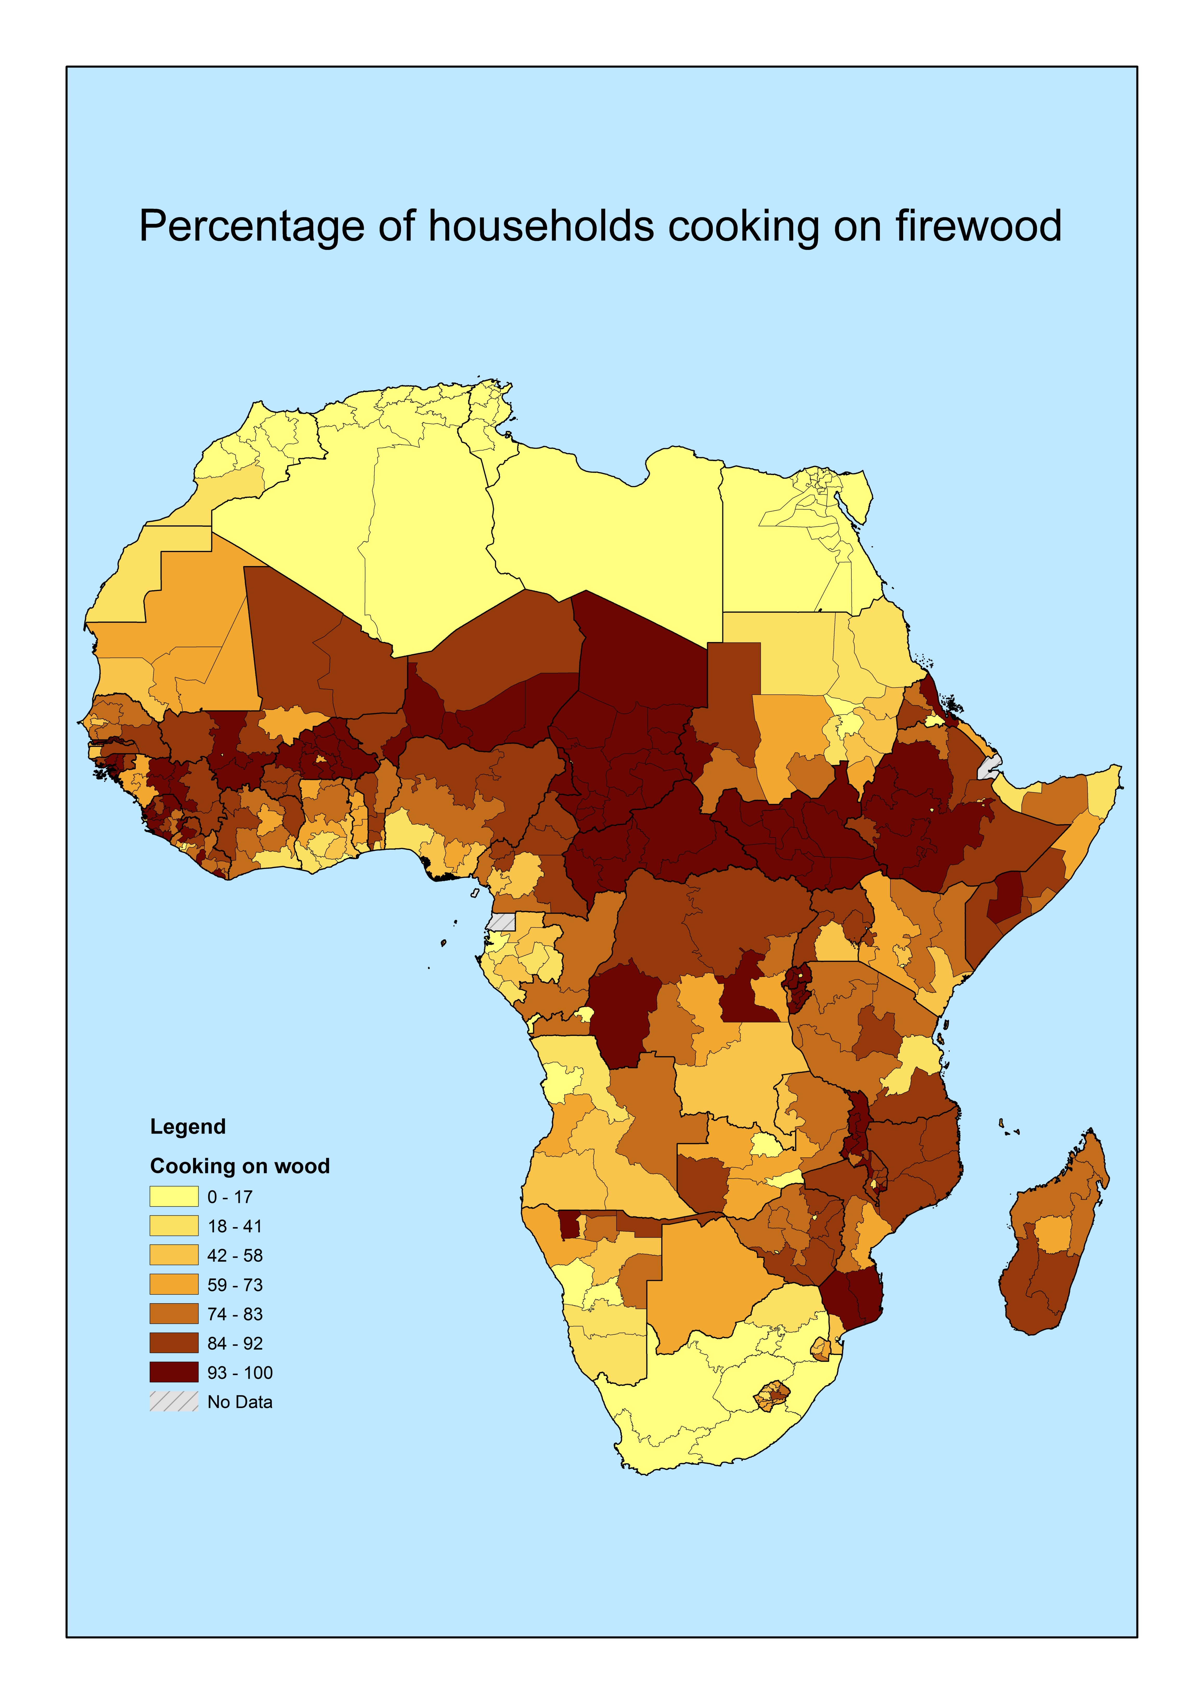

Slide 10
New approach
Indicators in Area Database only available for country-year combinations for which survey datasets are available
Since 2018 new approach whereby subnational versions of widely used national indicators are created
In this approach subnational variation of the indicator is derived from survey datasets, while its overall level is obtained by standardization around accepted national values
Currently available indicators:
Subnational Human Development Index (plus underlying indices)
Subnational Gender Development Index (plus underlying indices)
Subnational Corruption Index (grand, petty and total)
Subnational climate change Vulnerability Index

Slide 11
Subnational Human Development Index
The Human Development Index (HDI) indicates a country’s achievement in three key dimensions of development: education, health & income
UNDP’s flagship indicator and one of the most important indicators to assess countries’ socio-economic development.
Published yearly since 1990 by UNDP for almost all countries of the world (Human Development Reports)
One great disadvantage: Only national values (whereas differences within LMICs are huge)
We have created subnational versions of the HDI and its underlying indicators (Smits & Permanyer, 2019).
Instead of 160+ countries, 1600+ subnational regions, hence 10 times more detail

Slide 12
Construction SHDI
The SHDI was constructed in the same way as the HDI, but from subnational information on the four indicators
For wealthy countries derived from statistical offices and Eurostat
For poor countries derived from survey and census datasets
Not all indicators available for all regions -> Imputation
  GNIc estimated with International Wealth Index
  Life expectancy estimated with child mortality
  If one educational indicator was missing, only the other one was used
  Missing years estimated with interpolation or extrapolation
Many estimations, but not too problematic
Normalization around official national values of UNDP
Hence no absolute values derived from data, only sub-national variation
Details of procedure:
Nature Scientific Data (2019): www.nature.com/articles/sdata201938
Pop. & Development Review (2020): onlinelibrary.wiley.com/doi/full/10.1111/padr.12343

Slide 17
Gender Development Index
Besides the HDI, the Human Development Reports contain a number of other indicators, including indicators for gender (in)equality
Since the 1990s several gender indices were introduced (GDI, GEM, GII), which were not very successful.
In 2014 the Gender Development Index (GDI) was introduced, a simple and more useful index than some of the earlier ones
The GDI indicates a country’s achievement on gender (in)equality in human development by simply dividing female HDI by male HDI
A value of one thus indicates complete equality in human development between males and females.
A value below 1 indicates higher HD for males and a value above 1 higher HD for females

Slide 18
Subnational Gender Development Index
Since 2014, the GDI has been published yearly in the HDR for almost all countries of the world
However, just as the HDI, it was only available at national level, whereas gender (in)equality cannot be expected to be the same everywhere in a country
The position of women and gender norms may differ between ethnic, religious, educational and other groups, living in different mixtures in different areas of a country
To represent the resulting variety of within-country gender patterns well, a subnational gender index was needed
Therefore, Jeroen and I have created a subnational versions of the GDI (and its underlying indicators), called SGDI.
Instead of 151+ countries, 1600+ subnational regions
SHDI and SGDI are downloadable from www.globaldatalab.org/shdi/

Slide 19
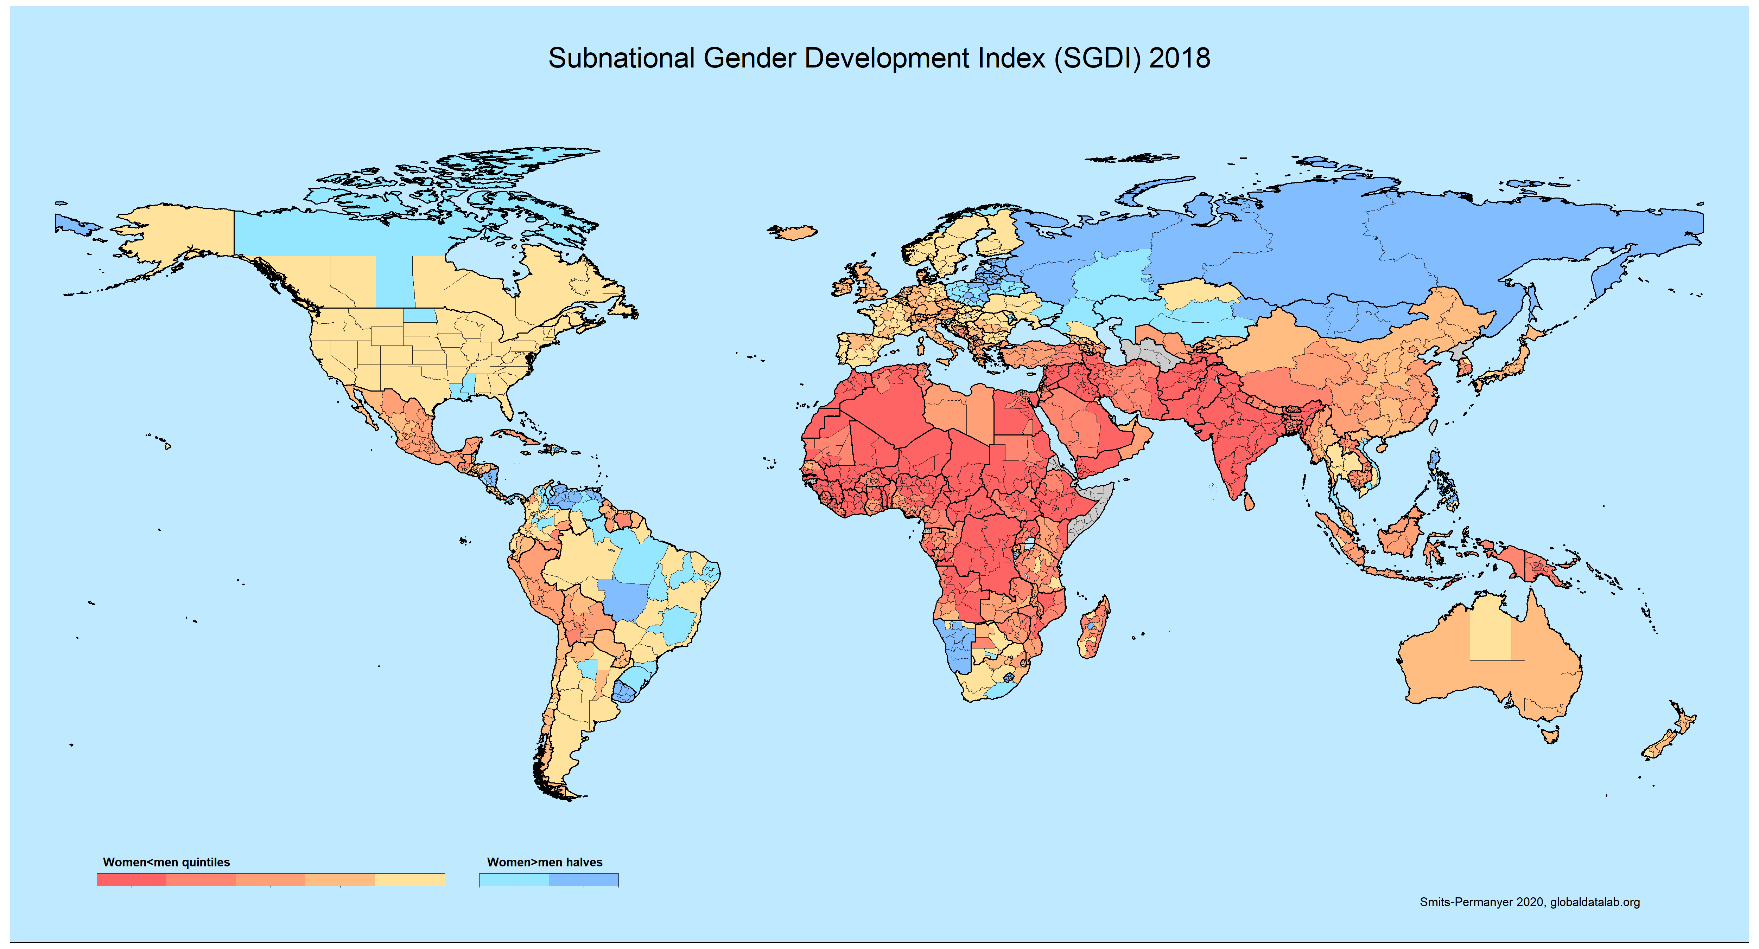

Slide 20
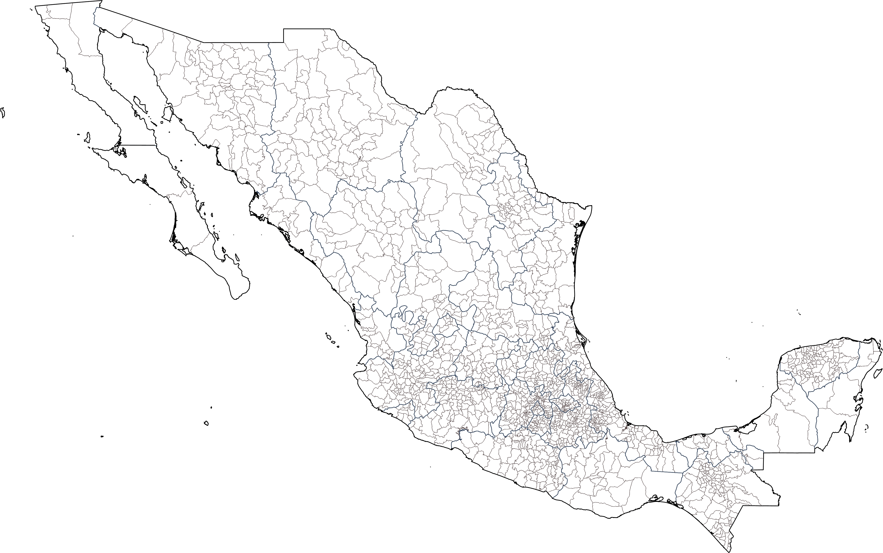
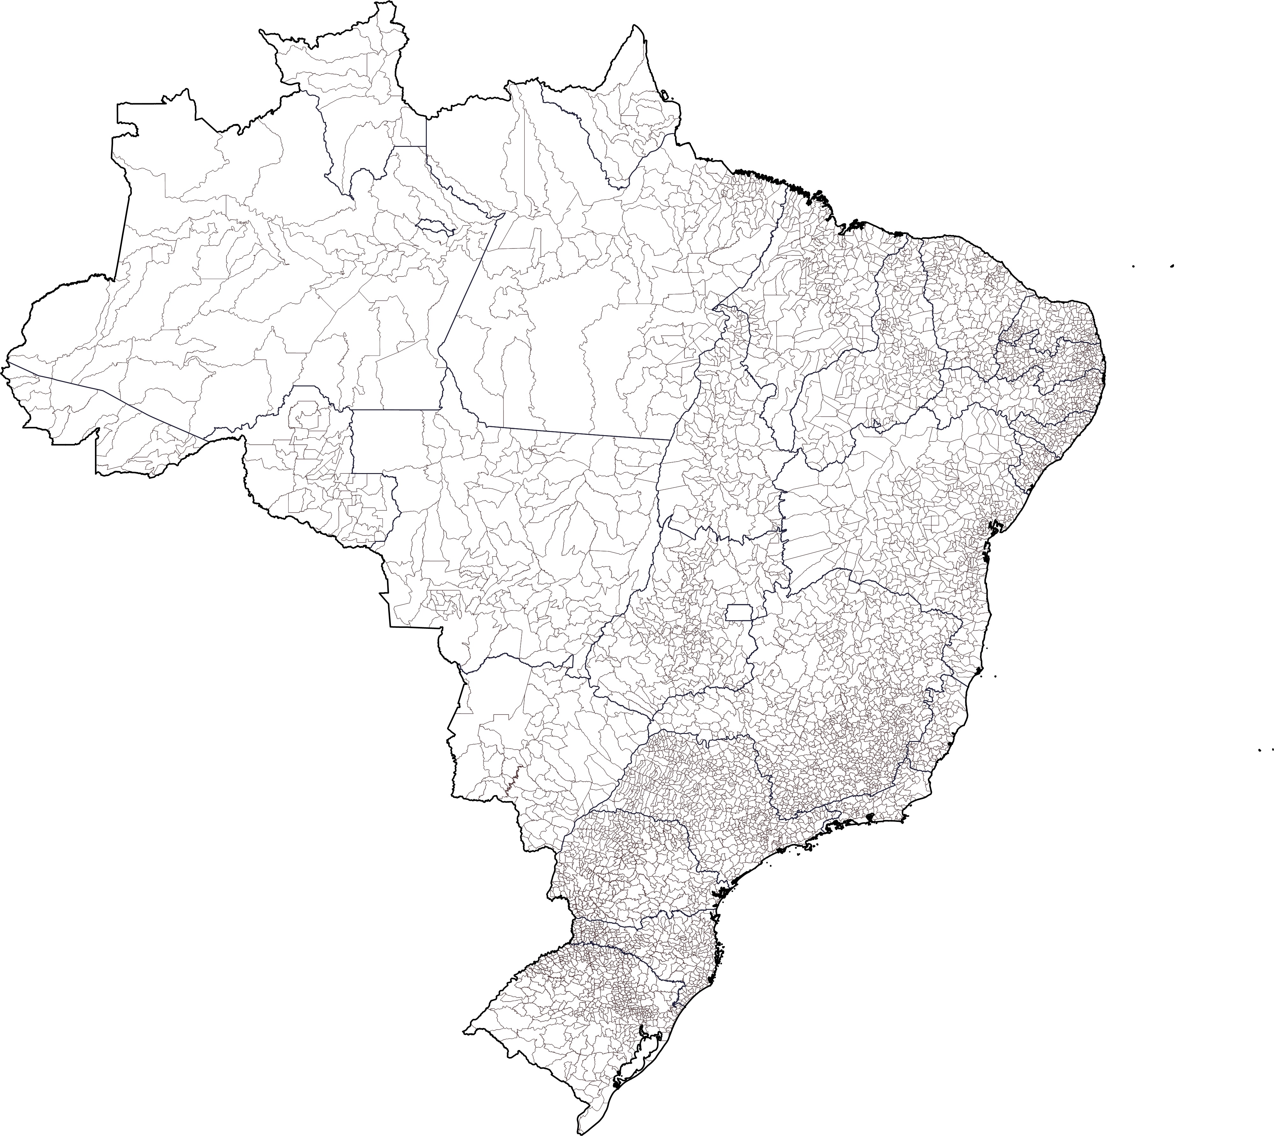
Heterogeneity within subnational areas? The cases of Mexico and Brazil

Slide 21
Heterogeneity within subnational areas?
The cases of Mexico and Brazil

Slide 22
Thank you very much for your attention!
www.globaldatalab.org

